Slide 1
Database Systems
Lecture 1
Chapter # 6
Basic SQL
Alina Arshad
alina.arshad@nu.edu.pk

Slide 2
Basic SQL(Structured Query language)
SQL Actually comes from the word “SEQUEL” which was the original term used in the paper: “SEQUEL TO SQUARE” by Chamberlin and Boyce. Pronounced as S-Q-L or sometimes as See-Quell.
SQL (Structured Query Language) is used to perform operations on the records stored in the database, such as:
Updating records
Inserting records
Deleting records
Creating and modifying database tables, views, etc.

Slide 3
Attribute Data Types
Numeric data types
SMALLINT(size) | A small integer. Signed range is from -32768 to 32767. Unsigned range is from 0 to 65535. The size parameter specifies the maximum display width (which is 255)
INT | A medium integer. Signed range is from -2147483648 to 2147483647. Unsigned range is from 0 to 4294967295. The size parameter specifies the maximum display width (which is 255)
INTEGER | Equal to INT(size)
FLOAT(p) | A floating point number. MySQL uses the p value to determine whether to use FLOAT or DOUBLE for the resulting data type. If p is from 0 to 24, the data type becomes FLOAT(). If p is from 25 to 53, the data type becomes DOUBLE()
Number(p,s) | Exact numerical, precision p, scale s. The maximum precision depends on the DBMS.
DECIMAL(size, d) | An exact fixed-point number. The total number of digits is specified in size. The number of digits after the decimal point is specified in the d parameter. The maximum number for size is 65. The maximum number for d is 30. The default value for size is 10. The default value for d is 0.
DEC(size, d) | Equal to DECIMAL(size,d)

Slide 4
Attribute Data Types
String Data Types
CHAR(size) | A FIXED length string (can contain letters, numbers, and special characters). The size parameter specifies the column length in characters - can be from 0 to 255. Default is 1
VARCHAR(size) | A VARIABLE length string (can contain letters, numbers, and special characters). The size parameter specifies the maximum column length in characters - can be from 0 to 65535
Date and Time Data Types
DATE | Represents a date. Format : dd-mm-yyyy, SYSDATE
TIMESTAMP | Format: dd-mm-yyyy hh:mm:ss, CURRENT_TIMESTAMP
TIMESTAMP WITH TIME ZONE | Represents a combination of DATE and TIME values separated by a space with time zone. Format : yyyy-mm-dd hh:mm:ss AT TIME ZONE -06:00.

Slide 5
Attribute Data Types
Binary large object Type:
BINARY LARGE OBJECT (BLOB). | BLOB stores a long sequence of bytes. For storing large pictures and sound etc.

Slide 6
SQL Data Definition
The CREATE TABLE command is used to specify a new relation by giving it a name and specifying its attributes and initial constraints.
Syntax
CREATE TABLE table_name (
column_name datatype constraint_name, column_name datatype constaint_name,
column_name datatype constaint_name,
....
);

Slide 7
SQL Data Definition
Base tables (base relations)
Relation and its tuples are actually created and stored as a file by the DBMS.
Virtual relations (views)
Created through the CREATE VIEW statement. Do not correspond to any physical file.

Slide 8
Specifying Attribute Constraints and Attribute Defaults
Relational Model has 3 basic constraint types that are supported in SQL:
Key constraint: A primary key column cannot have duplicate value
Entity Integrity Constraint: A primary key value cannot be null
Referential integrity constraints : The “foreign key “ must have a value that is already present as a primary key, or may be null.

Slide 9
Specifying Attribute Constraints and Attribute Defaults
NOT NULL: specified if NULL is not permitted for a particular attribute value.
CHECK: Restricting values in tuples.
Check is a row-based constraint.
Applies to each row individually and are checked whenever a row is inserted or modified.
Dnumber INT NOT NULL CHECK (Dnumber > 0 AND
Dnumber < 21);
DEFAULT: default value is included in any new tuple if an explicit value is not provided for that attribute.
Specified using DEFAULT <value>

Slide 10
Specifying Key and Referential Integrity Constraints
UNIQUE: Values in the column must be unique.
Specifies alternate (secondary) keys (called CANDIDATE keys in the relational model).
Dname VARCHAR(15) UNIQUE;
PRIMARY KEY: specifies one or more attributes that make up the primary key of a relation.
For only one column as a Primary key in a table.
Dnumber INT PRIMARY KEY
For more than one column as Primary Key.
PRIMARY KEY (Dnumber, Dlocation)

Slide 11
Specifying Key and Referential Integrity Constraints
FOREIGN KEY: Referential integrity is specified via the FOREIGN KEY.
Default action for integrity Violation: Reject the update operation (Restrict)
Alternative action to be taken by attaching a referential triggered action clause to any foreign key constraint.
The options include
SET NULL
CASCADE, and
SET DEFAULT
An option must be qualified with either ON DELETE or ON UPDATE.

Slide 12
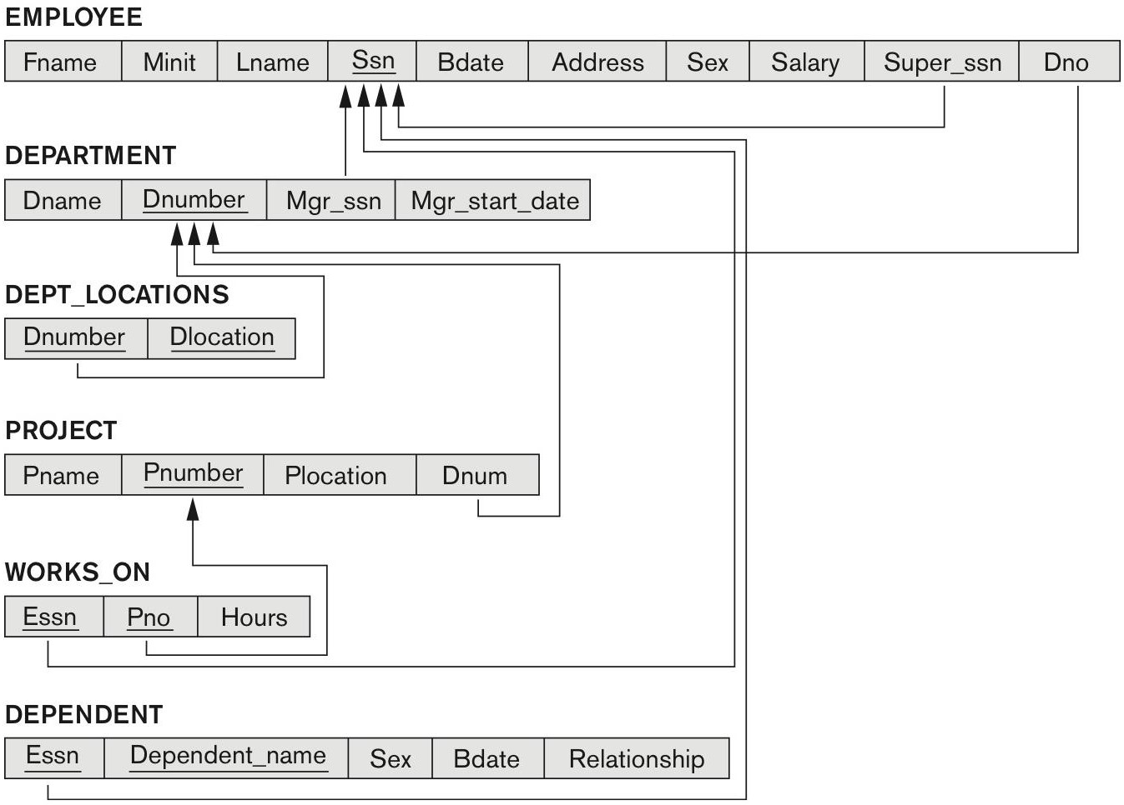
COMPANY relational database schema

Slide 13
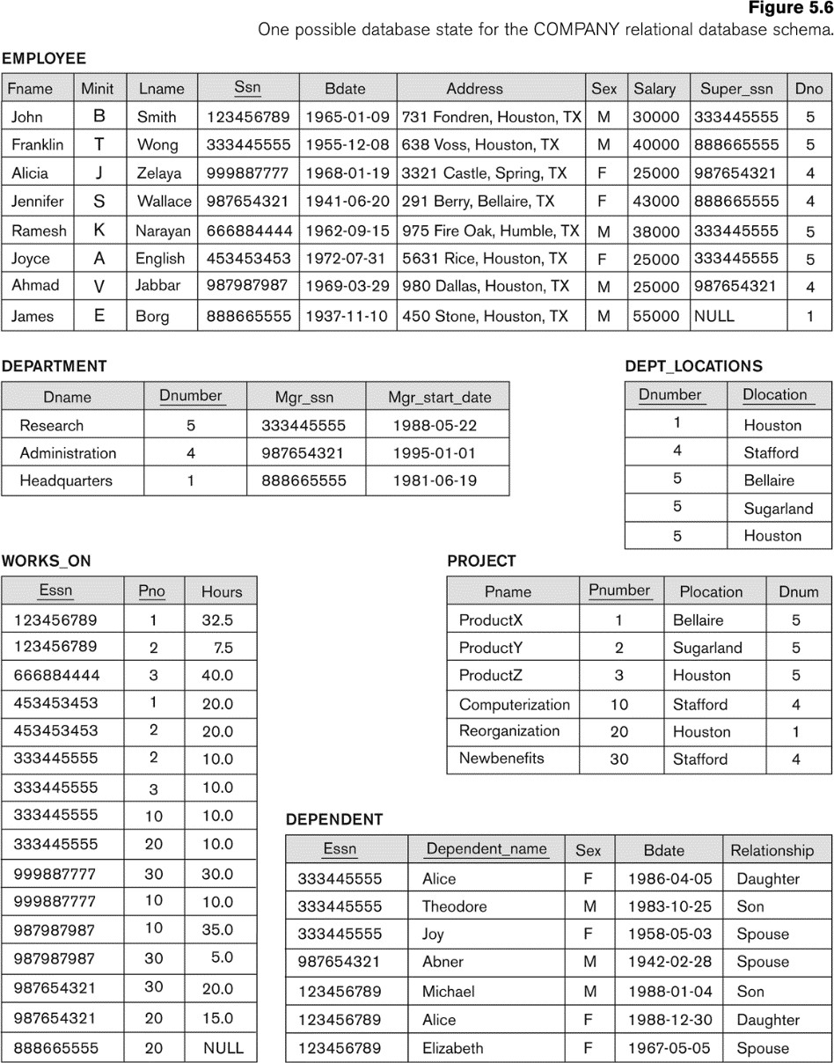

Slide 14
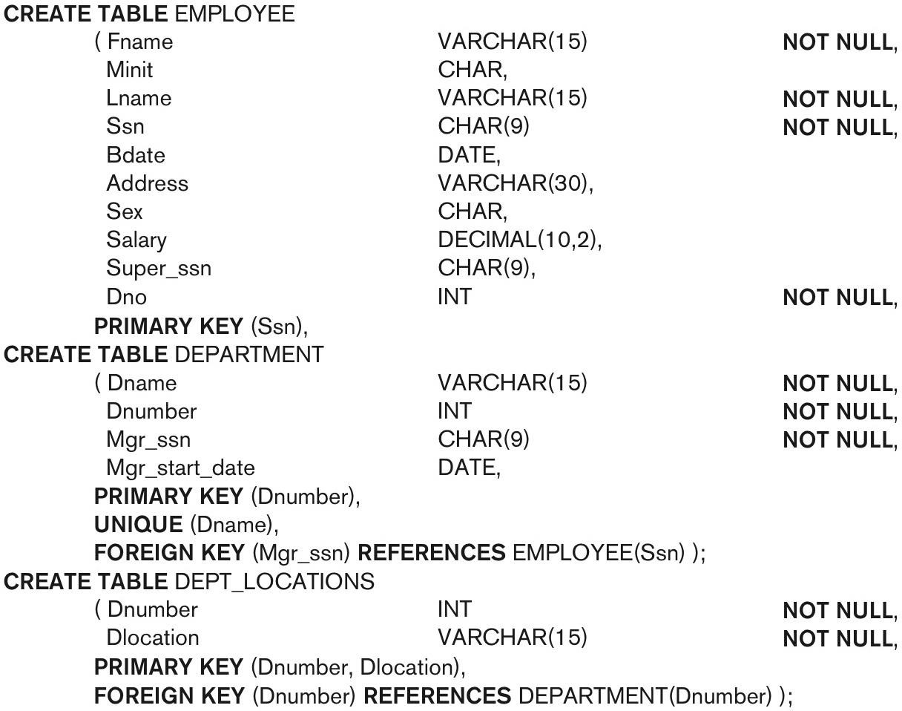

Slide 15
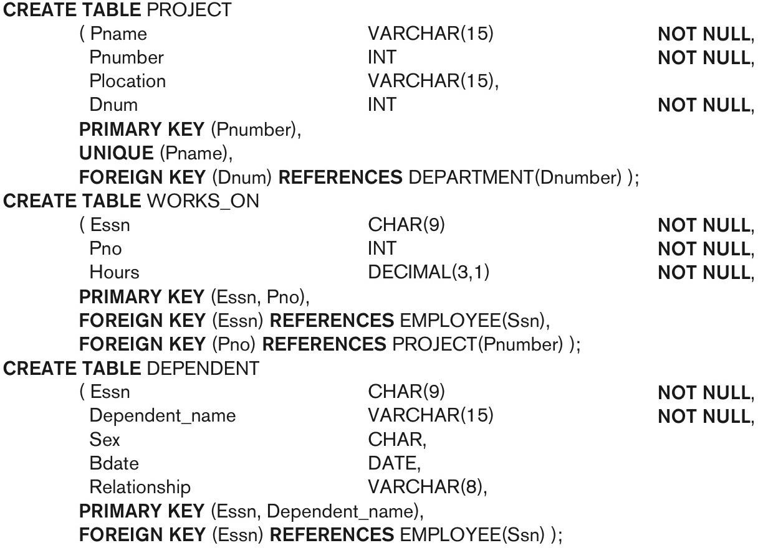
SQL CREATE TABLE data definition statements for defining the COMPANY schema from Figure 5.7 (Fig. 6.1)-continued

Slide 16
Create Table Using Another Table
A copy of an existing table can also be created using CREATE TABLE.
The new table gets the same column definitions. All columns or specific columns can be selected.
Syntax:
CREATE TABLE new_table_name AS SELECT column1, column2,...
FROM existing_table_name WHERE ....;

Slide 17
Example: Create Table Using Another Table
Example
CREATE TABLE TestTable AS
SELECT customername, contactname FROM customers;

Slide 18
SQL DROP TABLE Statement
DROP TABLE table_name;
Example:
DROP TABLE Persons;

Slide 19
Any question????

